Slide 1


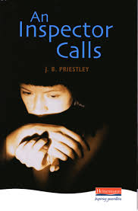
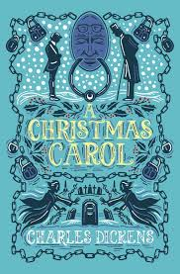
GCSE English
English Language
English Literature
March mock
Paper 1
Paper 2
Paper 1
Paper 2
Section A (Reading)
Unseen extract from a 20th or 21st Century story.
Section A
(Reading)
Two unseen extracts from 19th – 21st Century non-fiction
Section A
Shakespeare
‘Macbeth’
Section A
Modern drama
‘An Inspector Calls’
Upcoming mock exam (12th Dec)
Jan
mock
Section B (Writing)
Writing to describe or narrate (usually based on an image).
Section B (Writing)
Writing to express a viewpoint - explain, argue or persuade.
Section B
19th Century novel
A Christmas Carol
Section B
Poetry
Power and Conflict
Section C
Unseen Poetry

Slide 2
GCSE English
How can you support your child with Literature?
Ensure there is a copy of the text and revision guide at home
Encourage independent revision (bring books home, have a look through, talk you through an example of work)
Quotes/key vocabulary recall – flashcards
Encourage revision sessions within School (Monday)
Practice essay planning and
Organising a revision timetable with students
Really emphasise Poetry revision: they have 16 (12) poems to learn quotations for on top of their Literature texts
Useful websites/resources:
Mr Bruff YouTube– all literature (incl Poetry)
BBC bitesize
https://www.sparknotes.com
https://revisionworld.com/a2-level-level-revision/english-literature-gcse-level
Oak Academy
TikTok handles:
GCSE English Teacher @lisagcseenglish
GCSE English Tutor @sarahteachesgcseenglish
The Light Up Tutor @thelightuptutor

Slide 3

English Language
Q1: Read again the first part of the Source from lines 1 to 7.​
List four things from this part of the Source about the boy.​
[4 marks]
Q2: Look in detail at this extract from lines 1 to 15 of the Source. How does the writer use language here to describe the boy playing in the evening? [8 marks]
Q3: How does the writer use structure to interest the reader? [8 marks]
Q4: (from line 16 to end) A reviewer wrote: ‘This end part of the extract where the boy’s game comes to life takes a darker and more chilling tone.’ [20 marks]
To what extent do you agree?
Source A
The main character in this short story is a boy, though we don’t get to know his name or age. At this mid-point in the story, he is playing amongst some rubble on the site of a demolished building. Everything seems normal to begin with, however….
One evening, the boy was crouched on top of the mound making a new town out of a heap of broken glass. He liked this time of day best – after tea, before bed. The air seemed to get grainy as its colour changed from vinegary yellow to candyfloss blue. He could rub it between his fingers like dust and slow time down. At the top of the mound he was in charge and he didn’t want to go home to bed. He collected green glass shards1 and broken brown bottle necks. He tumbled fragments of old window in his hands like shattered marbles. He pushed the glass into the mound, making houses, balancing roofs on them, building towers. The last of the sunlight caught and glinted in the tiny glass walls. More of the black birds than he’d ever seen before rushed overhead and gathered on the lamppost. The orange light hadn’t yet switched on but the shadows were growing. He heard nine chimes of the town hall clock. For a moment, the lamppost looked like a tall thin man wearing a large black hat. When the man turned towards him, he looked like a lamppost. The man had a greyish-green coat speckled with rust and a black hat that quivered with beaks and feathers. The man didn’t need to climb the mound; he was face to face with the boy with his feet still planted in the pavement. ‘What are you making?’ asked the man. The boy didn’t answer. ‘Every child is always making something. Shake them out and they‘re full of dust and dreams.’ The boy stood up, ready to run, but then he remembered that at the top of the mound he was king. He dug his heels into the rubble. ‘I’m making a new town, better than this one. The sun can shine in through the walls. The buildings look grander. It’ll be a great glass city.’ ‘All it needs is people,’ said the man. ‘Yes, it needs people,’ said the boy. And when he looked down, tiny creatures were scuttling beneath the glass roofs. They looked like ants or spiders, but the sky was darkening and the creatures were moving too fast to be sure. He looked to the man but there was only the lamppost and as its orange light snapped on, the birds launched into the sky. The boy plunged down the mound and ran, hoping he wouldn’t get told off for being late home. Before he reached the end of the street he knew something was wrong. The world was too quiet. Where were the sounds of cars? Of footballs being kicked against walls? There were no shouts from parents calling everyone in. ‘Mum?’ He pushed open their front door. The house was in darkness but the telly was switched on. His mum wasn’t in any of the rooms. A half-drunk cup of tea had been left on the arm of the settee. The boy thundered back along the silent streets. He stood in the orange light beneath the lamppost. ‘Give them back,’ he shouted. Nothing happened, although he could hear the rustle of feathers coming from the darkness above the light.
Paper 2
Section A (Reading)
Unseen extract from a 20th or 21st Century story.

Slide 4
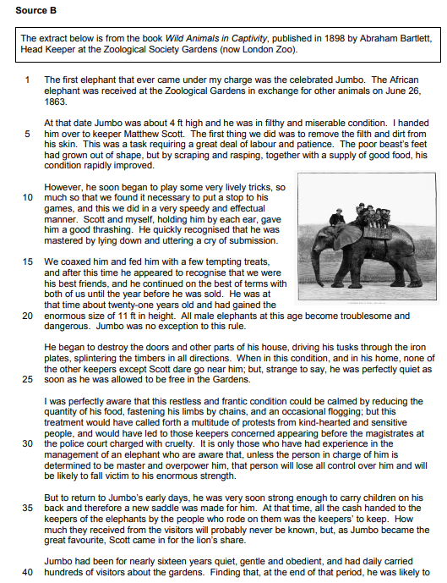
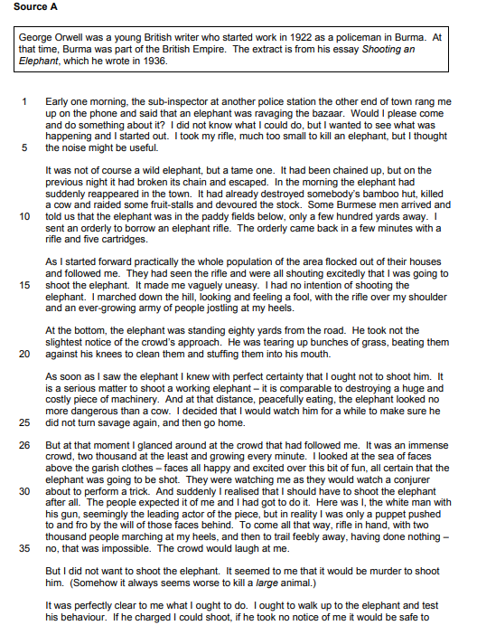

English Language
Paper 2
Section A ((Reading)
Two unseen extracts from 19th – 21st Century non-fiction
Q1: True or False
[4 marks]
Q2: Similarities/differences between the texts[8 marks]
Q3: How does the writer language to describe? [12 marks]
Q4: Compare the perspectives towards _________ [16 marks]

Slide 5
English Language
How can you support your child with Language?
Language relies on reading ability and being able to make inferences based on an extract.
Encourage students to do wider reading on topical issues.
Practice reading short fiction extracts and asking them to explode quotations/identify methods
Ask students to identify a writer’s viewpoint on a topic
Paper 1
Section A (Reading)
Unseen extract from a 20th or 21st Century story.
Paper 2
Section A ((Reading)
Two unseen extracts from 19th – 21st Century non-fiction

Slide 6
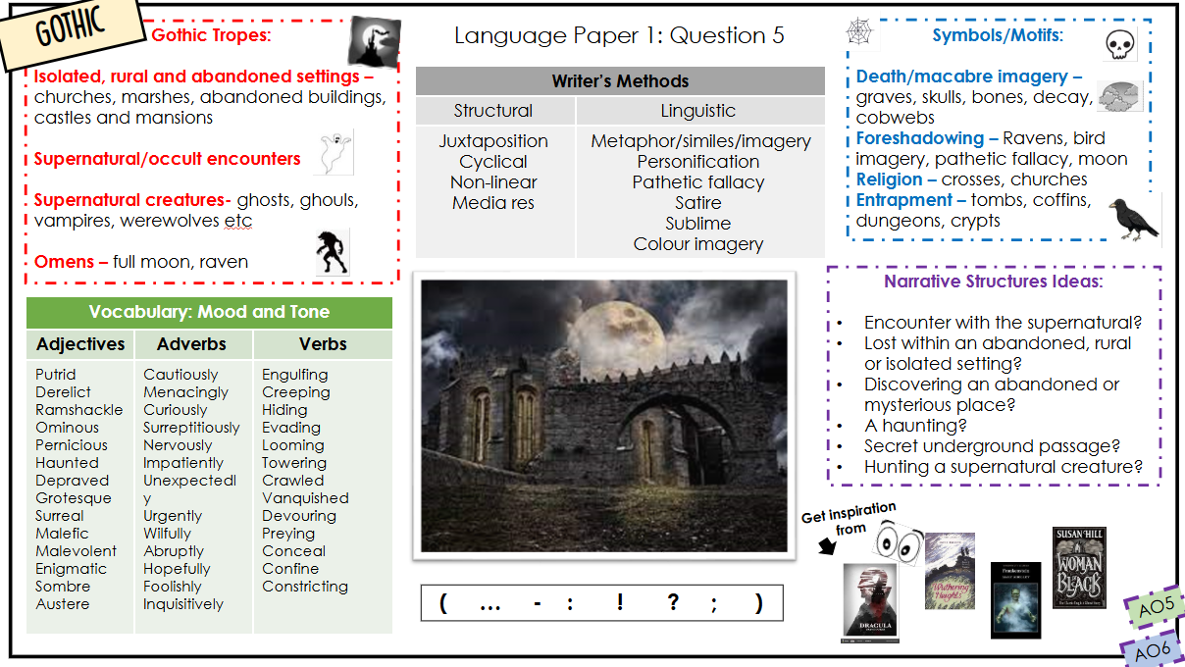
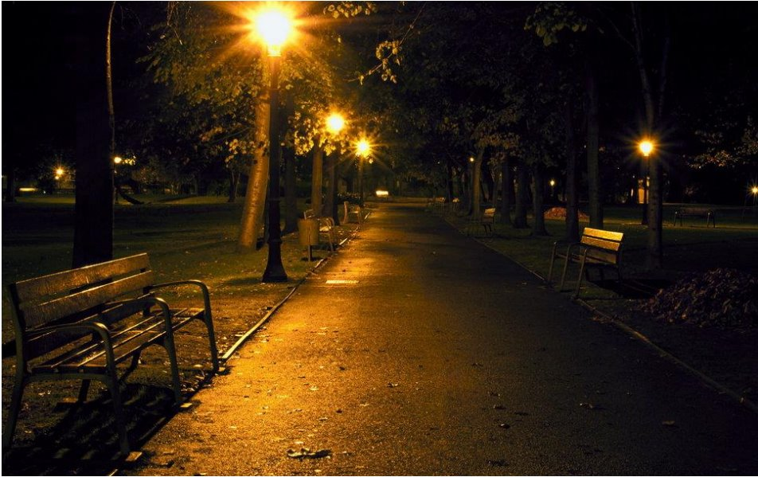
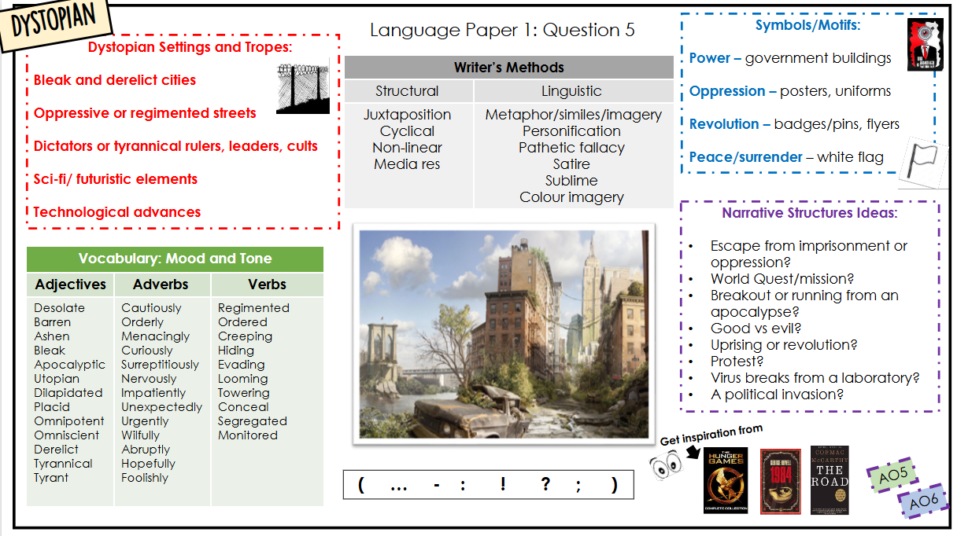
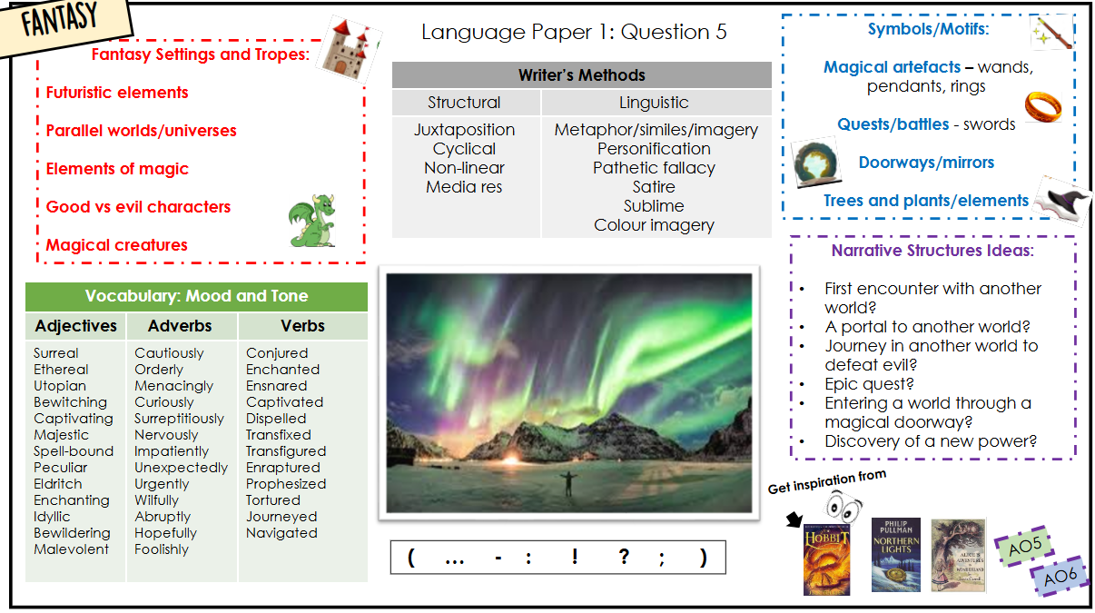
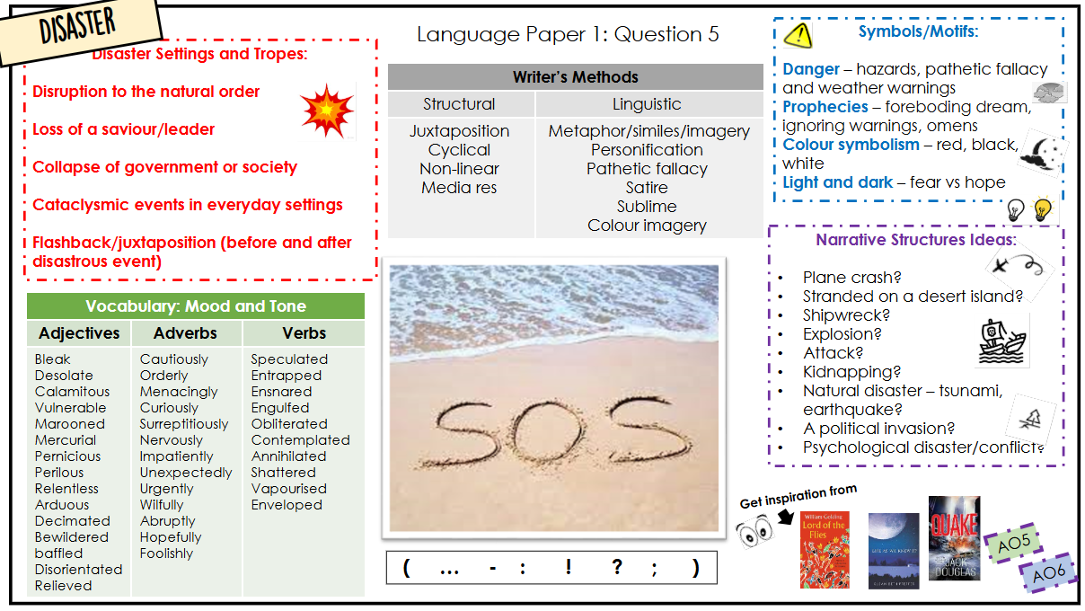
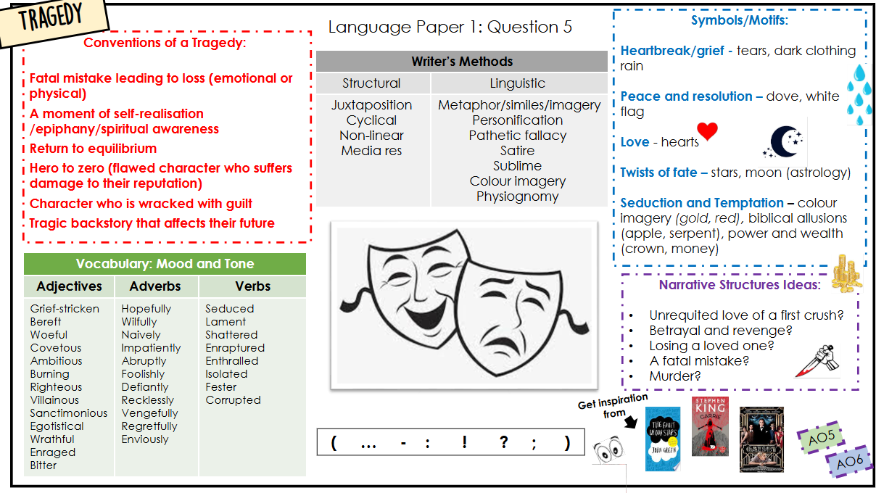
English Language
Writing
Paper 1
Section B (Writing)
Writing to describe or narrate (usually based on an image).
a) Write a description set on a dark night as suggested by
this picture:
b)Write a short narrative about a game that goes wrong.
(40 marks)
AO5: content (24)
AO6: SPaG (16)

Slide 7
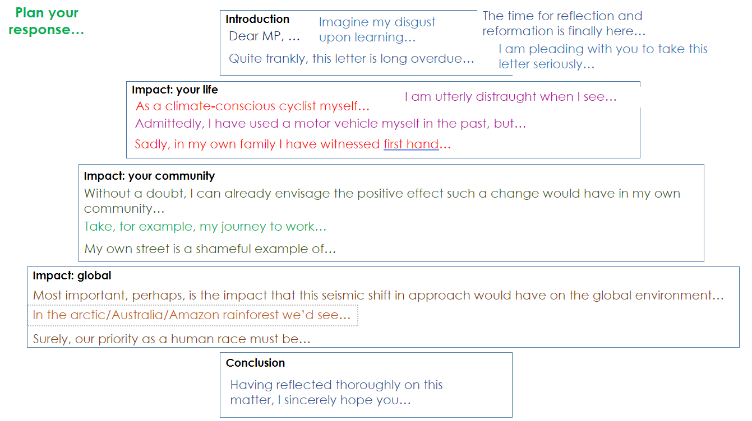


Language Paper 2: Question 5
Writing to argue
Hook
Point 1
Point 2
Point 3/
Counter argument
Ending
( … - : ! ? ; )
AO5
AO6

