Slide 2
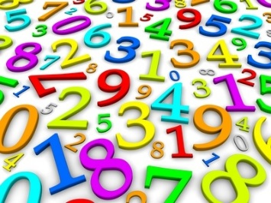
The only way to revise maths is to do maths!
(Little and often)

Slide 3
Exam Dates
(Pearson Edexcel)
GCSE Paper 1: Thursday 15 May 2025 (AM)
That’s 161 days away!
GCSE Paper 2: Wednesday 4 June 2025 (AM)
GCSE Paper 3: Wednesday 11 June 2025 (AM)

Slide 4
Maths……..
I can’t do maths
I don’t understand
When will I ever need this?
I’m confused
It’s too hard…..!

Slide 5
Revising Maths
Identify area or topic of weakness
Recap and review the topic using Maths Genie, Sparx Maths, Corbett Maths, exercise books, revision guides, etc.
Test yourself – can you now answer the exam questions?

Slide 6
Write 36 as the product of its prime factors.
Give your answer in index form.
3 marks

Slide 7
https://www.mathsgenie.co.uk/HCFLCM.html

Slide 8
Write 36 as the product of its prime factors.
Give your answer in index form.
3 marks

Slide 9
Write 36 as the product of its prime factors. Give your answer in index form.
3 marks
36
2
2
18
2
2
9
36 = 2 x 2 x 3 x 3
3
3
3
3
36 = 2² x 3²

Slide 10
General revision
Maths Genie: Topics questions
Papers (use AQA or OCR papers)
Corbett Maths: 5 a day
Practice papers

Slide 11
The only way to revise maths is to do maths!
(Little and often)

