Slide 1
How can I support my child with Science in Y11?
Ms Willis

Slide 2

Specification details
AQA
Biology 8461, https://www.aqa.org.uk/subjects/biology
Chemistry 8462, https://www.aqa.org.uk/subjects/chemistry
Physics 8463, https://www.aqa.org.uk/subjects/physics
Combined Science, Trilogy 8464, https://www.aqa.org.uk/subjects/science
Separate Science = 1 hour 45 minutes x 6 papers, 3 GCSEs
Combined Science = 1 hour 15 minutes x 6 papers, 2 GCSEs

Slide 3
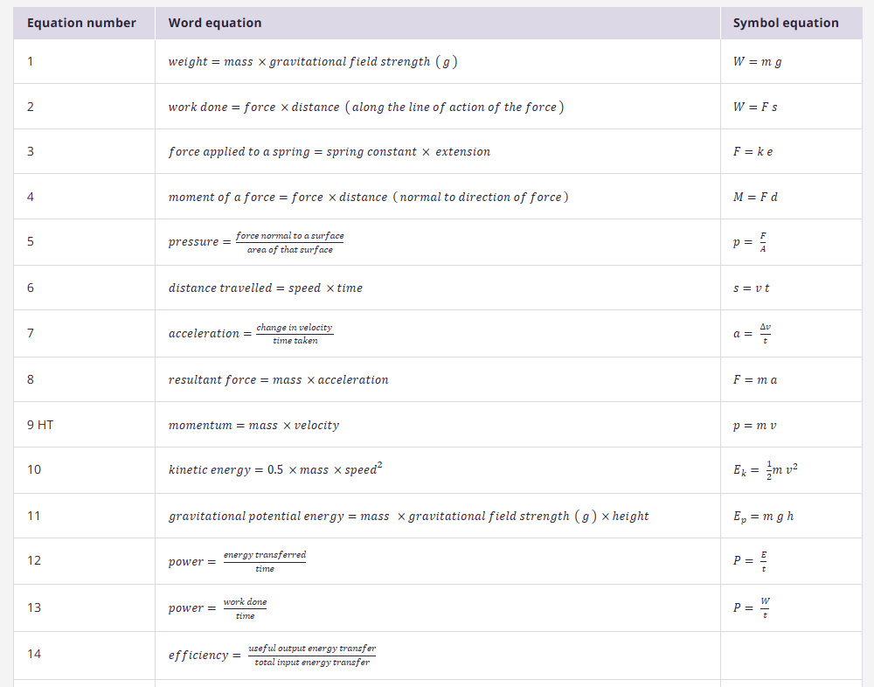
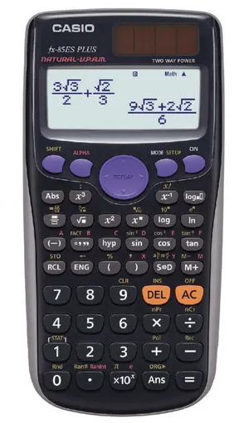
2025:
Formula sheets for Physics and Combined Science Physics will be provided!
Notes:
Equation sheets given 2022, 2023, 2024 and plan is to provide up to 2027 as well

Slide 4

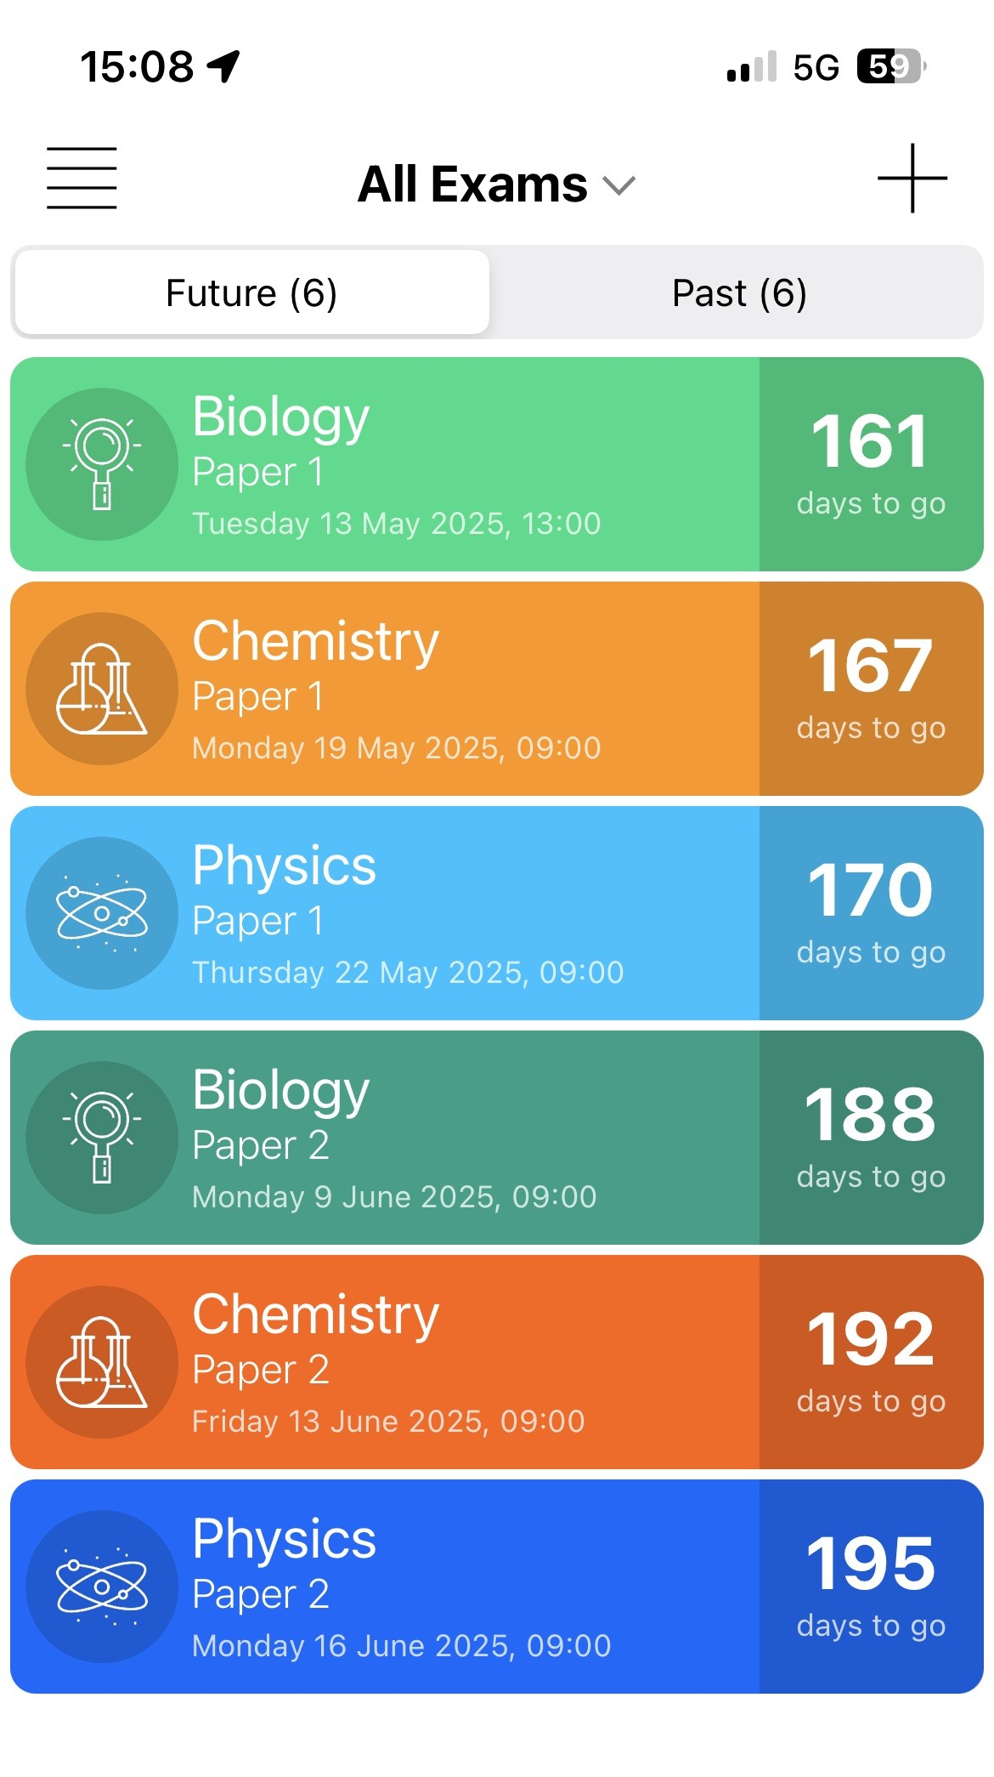
GCSE Separate and Combined Science EXAM DATES
Exam Countdown Lite
Biology Paper 1, Tuesday 13th May, p.m.
Biology Paper 2, Monday 9th June, a.m.
Chemistry Paper 1, Monday 19th May, a.m.
Chemistry Paper 2, Friday 13th June, a.m.
Physics Paper 1, Thursday 22nd May, a.m.
Physics Paper 2, Monday 16th June, a.m.
Notes:
Difference is separate science exam = 1 hour 45 minutes, combined science = 1 hour 15 minutes
F and H tier all taken at the same time.
App = £4.99 for the year, or free for the Lite version, don’t really need the paid for version (add free, sync with other devices, alerts) really simple, can add icons and different colours.
Add dates to your regular calendar too and phone calendars can give you alerts nearer the time too.
Mocks second and third week back after Christmas

Slide 5
Topics covered on each paper
– see specification
Combined Sciences
Working scientifically & Practical Skills – all papers
Biology Paper 1, Topics 1-4
Biology Paper 2, Topics 5-7
Chemistry Paper 1, Topics 8-12
Chemistry Paper 2, Topics 13-17
Physics Paper 1, Topics 18-21
Physics Paper 2, Topics 22-24
Separate Sciences
Working scientifically & Practical Skills – all papers
Biology Paper 1, Topics 1-4
Biology Paper 2, Topics 5-7
Chemistry Paper 1, Topics 1-5
Chemistry Paper 2, Topics 6-10
Physics Paper 1, Topics 1-4
Physics Paper 2, Topics 5-8

Slide 6
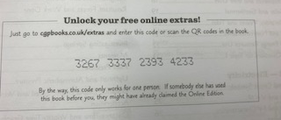
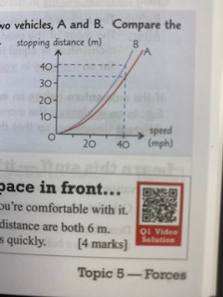
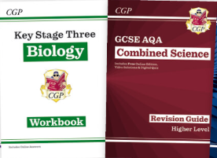

CGP
£6.50 Trilogy
£3.25 each so £9.75
Biology/Chemistry/Physics
www.cgpbooks.co.uk
QR codes take you to videos that work through answers to the questions for you
Access online content. You can only use each code once, but you can use the content on more than one device, you just need to create an account and log in.

Slide 7
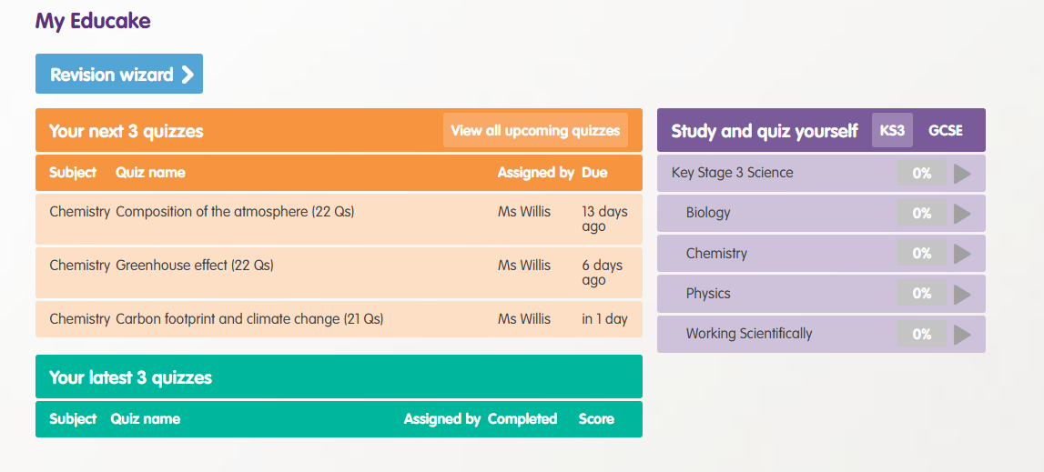

Educake
https://www.educake.co.uk/resources/

Slide 8

Seneca
https://senecalearning.com/en-GB/

Slide 9
Focus
By visiting: www.focuselearning.co.uk
Username: student@northgosforth39317
Password: g4y0dgqgn

Slide 10
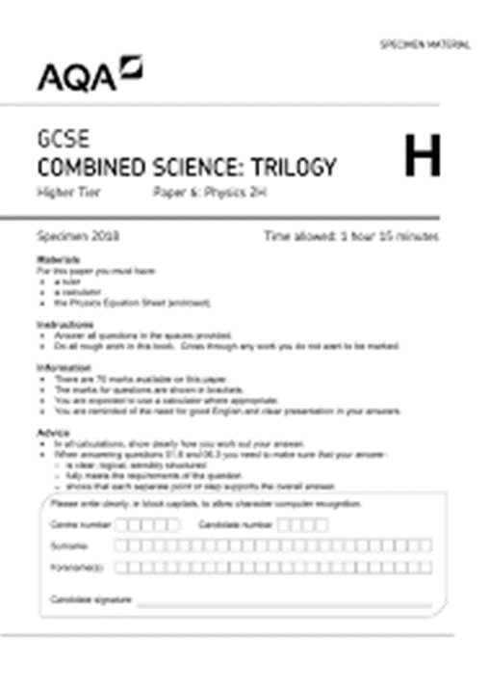
Practice papers
https://www.physicsandmathstutor.com/
From memory
Using revision guide
Bullet point answers
Use mark scheme/ examiner reports
Make a bank of questions from exam papers
A question a day

Slide 11

Flashcards
https://quizlet.com/en-gb

Slide 12
Some tips
1. Make a start!
2. Get organised – make a timetable and also plan what you will try and cover each session
Include the things you find most difficult
Don’t copy out the revision guide/ watch videos – be active, do something from memory every time you revise
Brain dump everything you can remember on that topic at the start and end of every revision session

Slide 13
Day | 8.40 – 9.40 P1 | 9.40-10.40 P2 | 11:20 – 12:20 P3 | 12.20-1.20 P4 | 1.20-2.00 Lunch | 2.00-3.00 P5 | 3:00 – 4:00 (Revision / Intervention) | 4:00 – 5:00 | 5:00 – 6:00 | 6:00 – 7:00 | 7:00 – 8:00 | 8:00 – 9:00
Monday
Tuesday
Wednesday
Thursday
Friday
Saturday
Sunday
Holidays different to term time
2 blocks out of 3 each day
Little and often

Slide 14
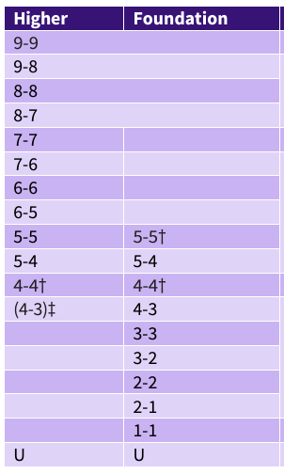
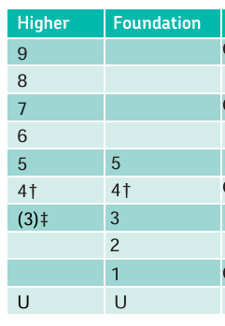
Combined Science - Trilogy
Separate Science
Foundation tier
Higher tier
Notes:
Trilogy
Grade 4-4 is the lowest targeted grade on the Higher tier. However, there is a small safety net for students who narrowly fail to achieve grade 4-4. The number of marks between the grade 5-4 and grade 4-4 boundaries is divided by 2 and subtracted from the grade 4-4 boundary. Students whose mark is on or above this threshold but below the grade 4-4 boundary are awarded grade 4-3. Higher tier students whose mark is below this threshold are ungraded (U).
Separate Science
Grade 4 is the lowest targeted grade on the Higher tier. However, there is a small safety net for students who narrowly fail to achieve grade 4. The number of marks between the grade 5 and grade 4 boundaries is divided by 2 and subtracted from the grade 4 boundary. Students whose mark is on or above this threshold but below the grade 4 boundary are awarded grade 3. Higher tier students whose mark is below this threshold are ungraded (U).

Slide 15
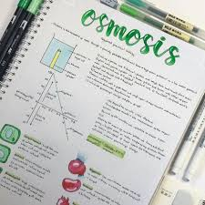
Read, cover, check, add
Read through your notes/ revision guide
Hide them
Write down everything you can remember FROM MEMORY
Draw diagrams
Summarise
Do this after every revision session
Check what you missed/ got wrong
Add/ amend the bits you missed/ got wrong in a different coloured pen
Allow some forgetting time, then repeat, repeat, repeat.

Slide 16
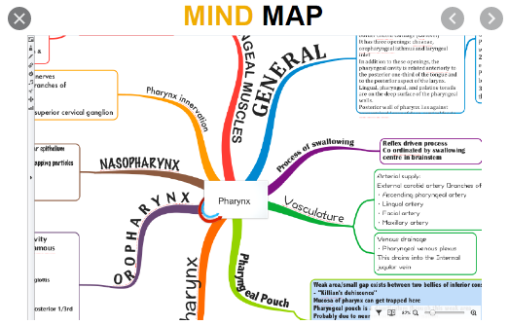
Mind Maps
Use notes/ revision guide
Colour
Images
Key ideas
Links
Pin them up around your room
Stick post it notes up

Slide 17
Teach someone else
Teach someone at home everything you know

Slide 18
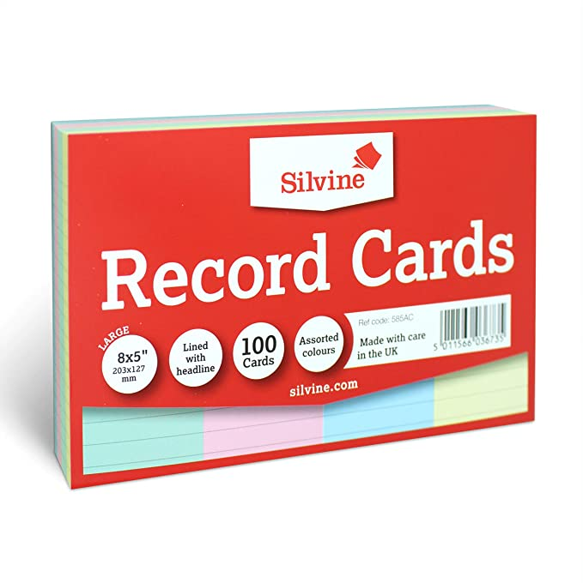
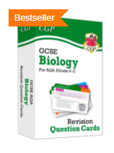
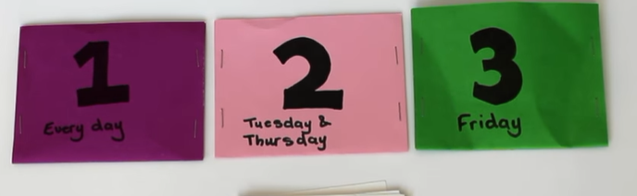
Flashcards
From memory
Keyword definitions – use the specification or your exercise book
Leitner method
https://www.youtube.com/watch?v=C20EvKtdJwQ

Slide 19
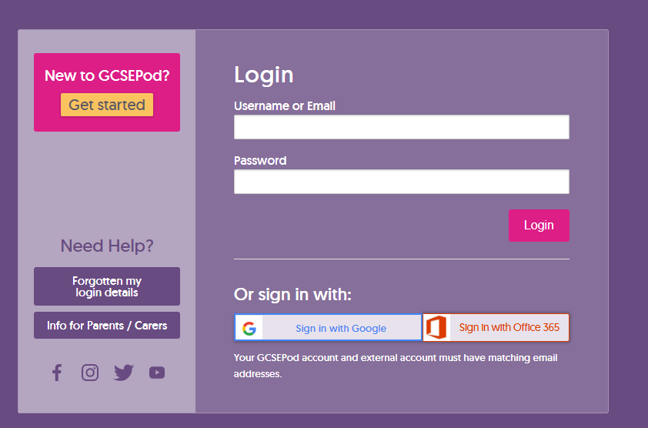
GCSE pod
https://members.gcsepod.com/login/

Slide 20

Videos – Free science lessons
https://www.freesciencelessons.co.uk/videos/

Slide 21
Primrose Kitten
https://www.primrosekitten.com/pages/gcse-science

Slide 22
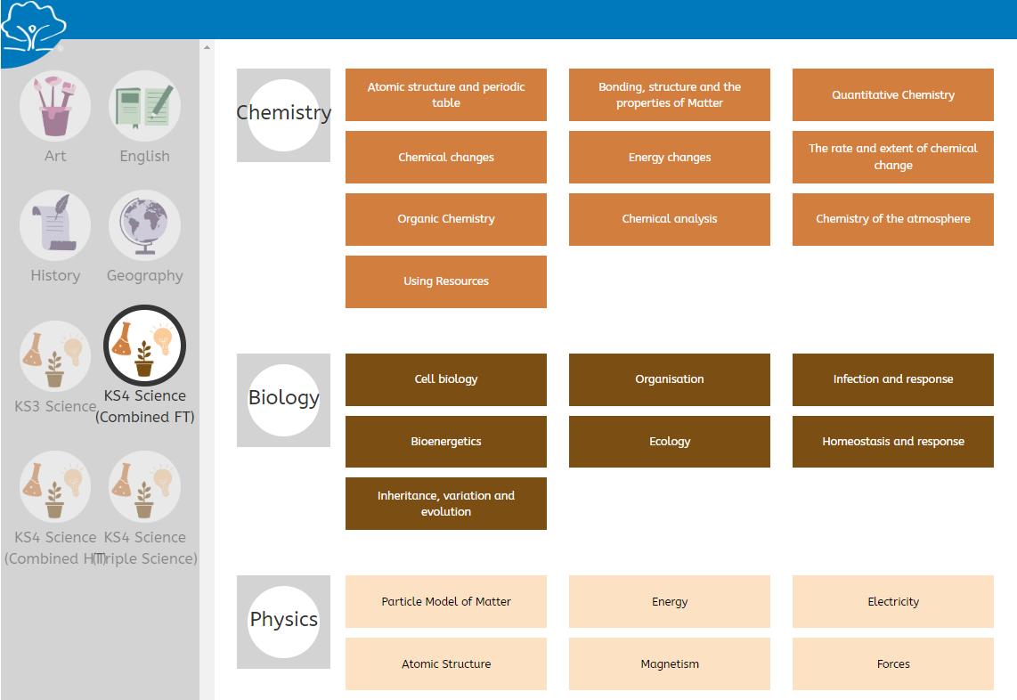
Oak National Academy
https://continuityoak.org.uk/lessons#

Slide 23
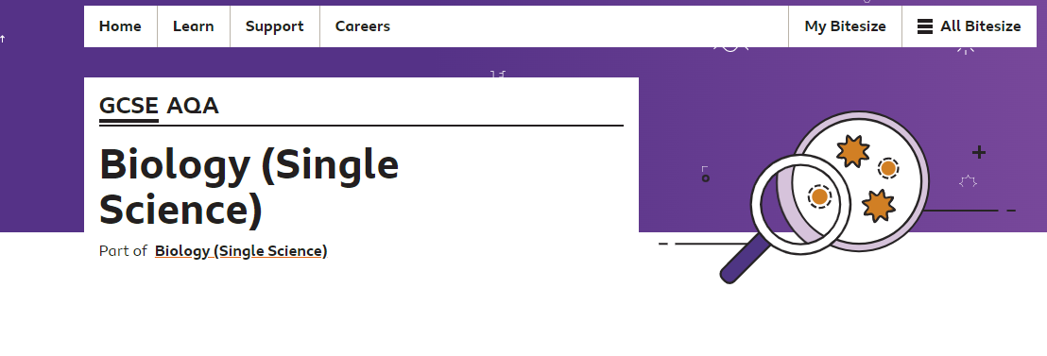
BBC Bitesize

