Slide 2
Welcome!
Working together to help achieve the best results we can
Key dates
Gosforth 6th form introduction
Core subject revision support

Slide 3
Key DATES
Year 11 after school revision sessions – Started on Monday 10th November
Year 11 revision evening – Thursday 13th November 5pm to 6.30pm
Year 11 mock exams – Start Monday 8th December
Year 11 parents evening – Thursday 22nd January 2026 3.30pm to 6.30pm
Year 11 exam information evening – Wednesday 22nd April 2026 5.30pm to 6.30pm
Year 11 exams start – Friday 8th May 2026

Slide 4
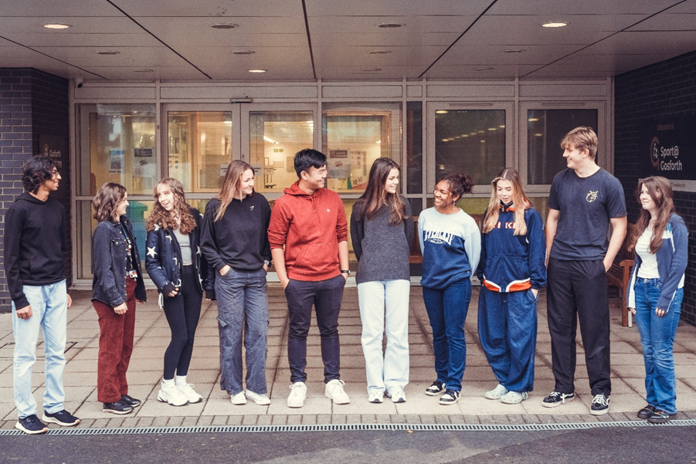
Sixth Form at Gosforth Academy

Slide 5





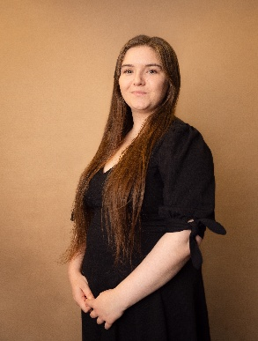
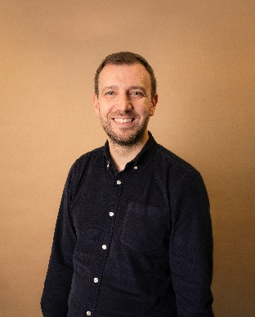





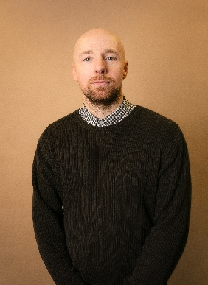
Sixth Form Team – Specialised Support

Slide 6

Comprehensive Choices
Wide range of A Level courses
6 Level 3 BTEC and CTEC and AAQ courses
Level 2/3 Access for A Levels course
Extended Project Qualification (EPQ)
Rugby Academy: ACE & DiSE
Resit GCSE English and Maths

Slide 7
Some of our courses…
Psychology
Sociology
Economics
Accounting
Film Studies
Law
Government and Politics
Textiles
Photography

Slide 8
Entry requirements
Four grade 4s at GCSE or equivalent for Level 3 courses.
Four grade 3s at GCSE or equivalent for Access for A Levels.
The Bridging Course enables you to make informed choices.
Check entry requirements carefully for each course: GCSE grades, GCSE courses and APS (see prospectus).
It is possible to mix and match A levels and Vocational courses.
Notes:
As you can see from our entry requirements, we enable students with a wide range of abilities to come to our Sixth Form. There is even an Access for A Levels course that runs for one year for those students who don’t get 4 grade 4s at GCSE. This course enables you to resit English and Maths GCSE if you need to and some students progress onto Level 3 courses the following year. Please take the time to look at the entry requirements for each course that you want to study and think about realistic choices. These entry requirements vary course by course and have been devised on the basis of what students have needed in the past to have at GCSE in order to go on to pass each A Level course. There is an explanation at the front of the prospectus of how to calculate your average point score, or APS.

Slide 9

Sixth Form Facilities
Sixth Form Library
Sixth Form workrooms
Common Room
Breakout space
Sport@Gosforth Cafe
Notes:
One of the benefits of the Sixth Form is that you have dedicated spaces just for you. These include the common room and break out space, as well as learning spaces such as the library and workrooms, where you can have computer access. Lockers are also available in the common room.

Slide 10

Extracurricular Opportunities
Debating Society
Feminist Society
Music
MedSoc
Duke of Edinburgh
World Challenge
MFL Exchanges and Trips
Charity Activities – e.g. Hoppings School and Food Bank collections
Student Union
Peer and Reading Mentors
Notes:
This slide gives you a flavour of some of the extra-curricular activities we run. There is a huge range of clubs, activities, trips and adventures in which you can participate in the Sixth Form, including the Duke of Edinburgh award and World Challenge. Many of the clubs are set up and run by students themselves, giving you the chance to show leadership skills.

Slide 11
Careers and Progression Activities
Careers Fair
Alumni & Career insight talks
A wide range of work and university related trips
Other supported provider events and programmes
Work Experience
One to one support and guidance from in-house careers advisers

Slide 12

Sport and Fitness
Some of the Sport and Fitness opportunities include:
  Basketball Club
  Football Club
  Netball Club
Free use of the Sport@Gosforth gym during the school day (from P3 onwards).

Slide 13
Key Dates 2025-26: Admissions Process
Sixth Form Open Evening: Thursday 8th January 2026 6-8pm
Applications must be made by 30th January 2026: phone or email the school
Progression Appointments: 9th – 13st February 2026 at Gosforth
Offer Letters 9th March 2026
Bridging Course: 29thJune – 3rd July 2026
Enrolment: 20th August 2026 (GCSE Results Day!)

Slide 14
Revision support from our Core subjects

Slide 15
Maths
Mrs Stewart

Slide 16

The only way to revise maths is to do maths!
(Little and often)

Slide 17
Exam Dates
(Pearson Edexcel)
GCSE Paper 1: Thursday 14th May 2026 (AM)
That’s 181 days away!
GCSE Paper 2: Wednesday 3rd June 2026 (AM)
GCSE Paper 3: Wednesday 10th June 2026 (AM)

Slide 18
Maths……..
I can’t do maths
I don’t understand
When will I ever need this?
I’m confused
It’s too hard…..!

Slide 19
Revising Maths
Identify area or topic of weakness
Recap and review the topic using Maths Genie, Sparx Maths, Corbett Maths, exercise books, revision guides, etc.
Test yourself – can you now answer the exam questions?

Slide 20
Write 36 as the product of its prime factors.
Give your answer in index form.
3 marks

Slide 21
https://www.mathsgenie.co.uk/HCFLCM.html

Slide 22
Write 36 as the product of its prime factors.
Give your answer in index form.
3 marks

Slide 23
Write 36 as the product of its prime factors. Give your answer in index form.
3 marks
36
2
2
18
2
2
9
36 = 2 x 2 x 3 x 3
3
3
3
3
36 = 2² x 3²

Slide 24
General revision
Maths Genie: Topics questions
Papers (use AQA or OCR papers)
Corbett Maths: 5 a day
Practice papers

Slide 25
The only way to revise maths is to do maths!
(Little and often)

Slide 26
English
Miss Hall

Slide 27




GCSE English
English Language
March mock
English Literature
Paper 1
Paper 2
Paper 1
Paper 2
Section A (Reading)
Unseen extract from a 20th or 21st Century story.
Section A
(Reading)
Two unseen extracts from 19th – 21st Century non-fiction
Section A
Shakespeare
‘Macbeth’
Section A
Modern drama
‘An Inspector Calls’
Upcoming mock exam (Dec)
Jan
mock
Section B (Writing)
Writing to describe or narrate (usually based on an image).
Section B (Writing)
Writing to express a viewpoint - explain, argue or persuade.
Section B
19th Century novel
A Christmas Carol
Section B
Poetry
Power and Conflict
Section C
Unseen Poetry

Slide 28
GCSE English
How can you support your child with Literature?
Little and often! Short burst recall/practice tasks.
Ensure there is a copy of the text and revision guide at home
Encourage independent revision (bring books home, have a look through, talk you through an example of work)
Quotes/key vocabulary recall – flashcards
Encourage revision sessions within School
Organising a revision timetable with students

Slide 29
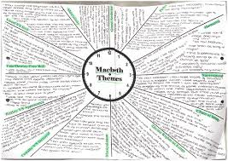
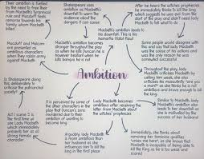
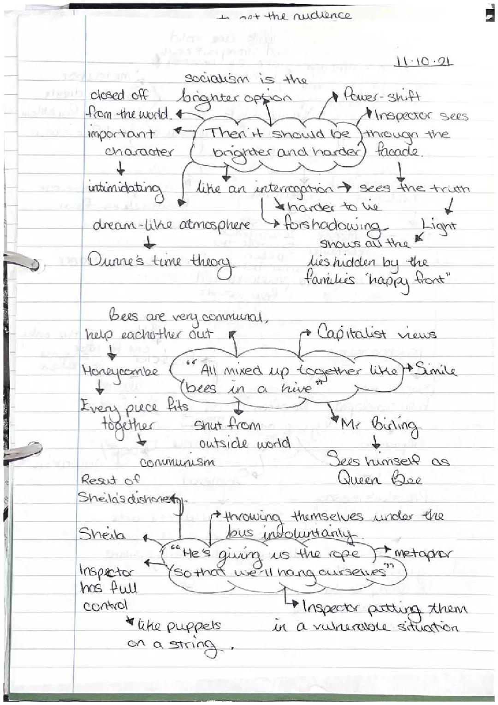
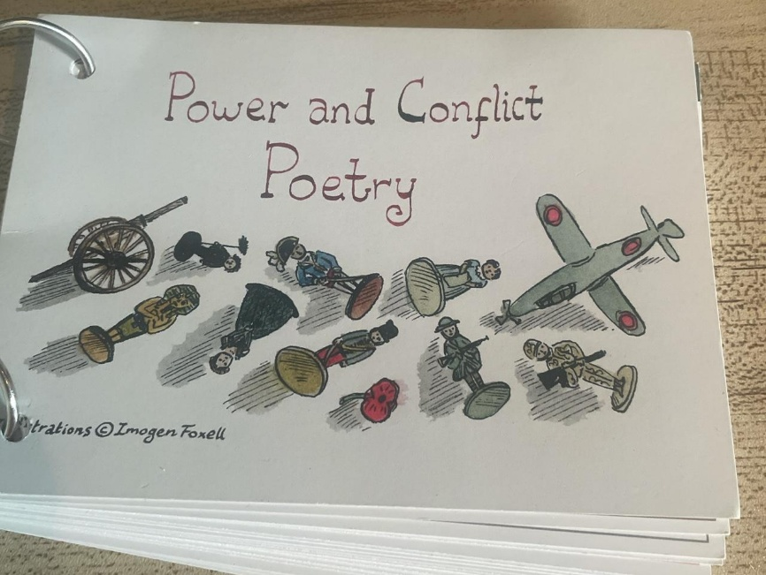
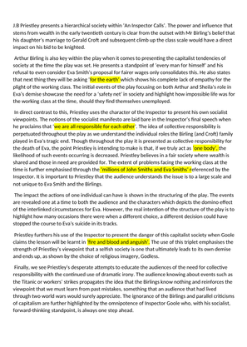
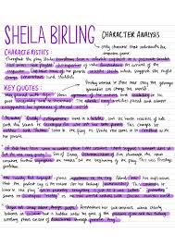
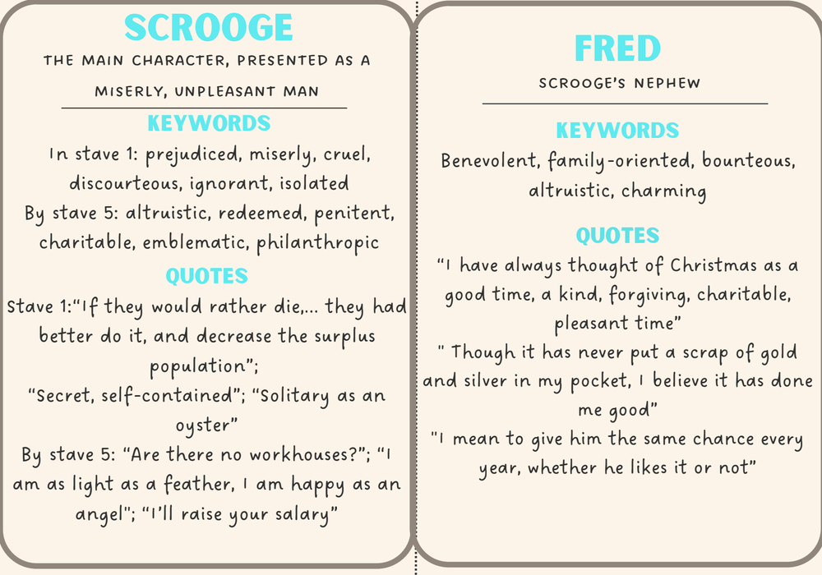
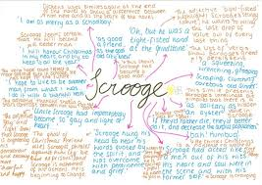
GCSE English
What kind of revision tasks work best in English?

Slide 30
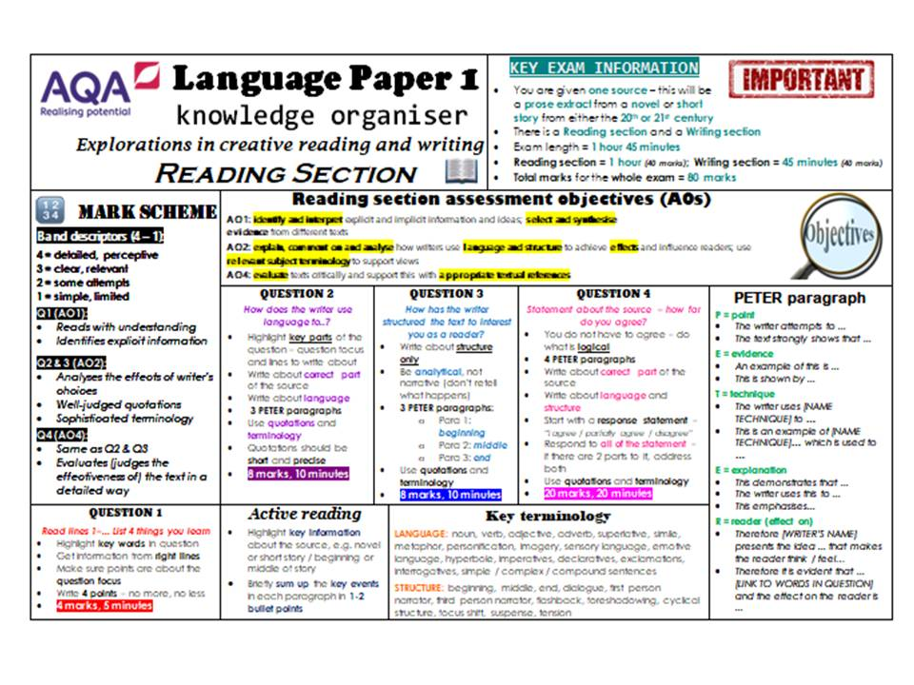
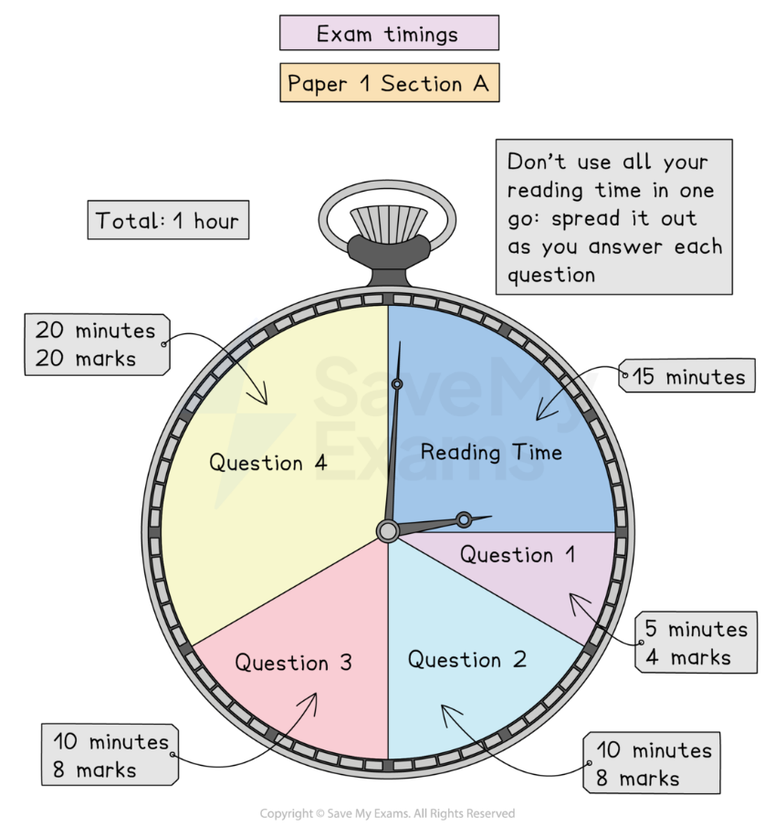
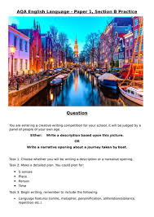
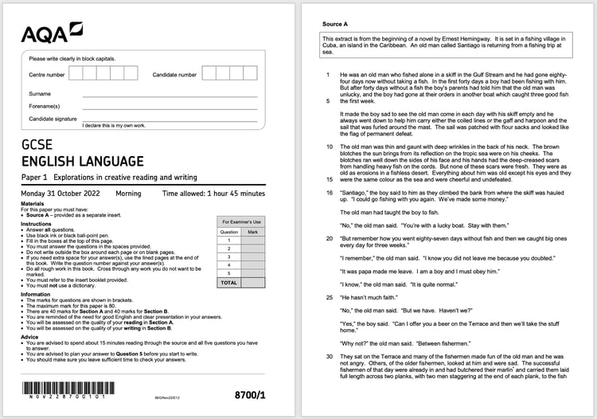
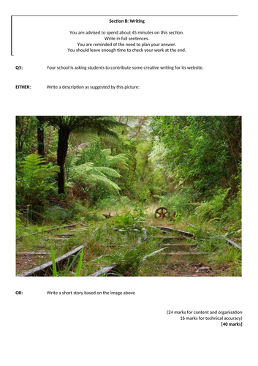

Slide 31
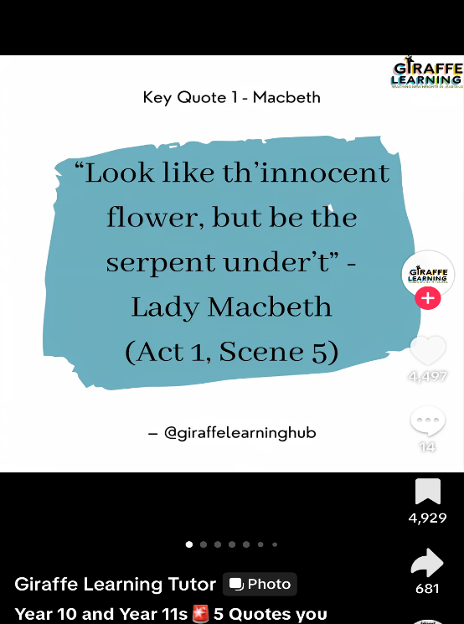
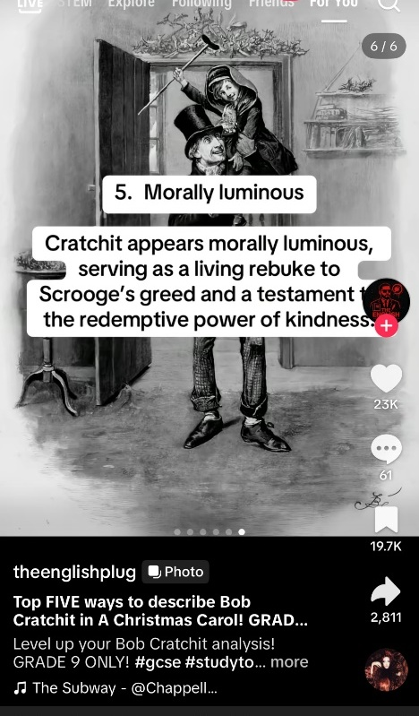
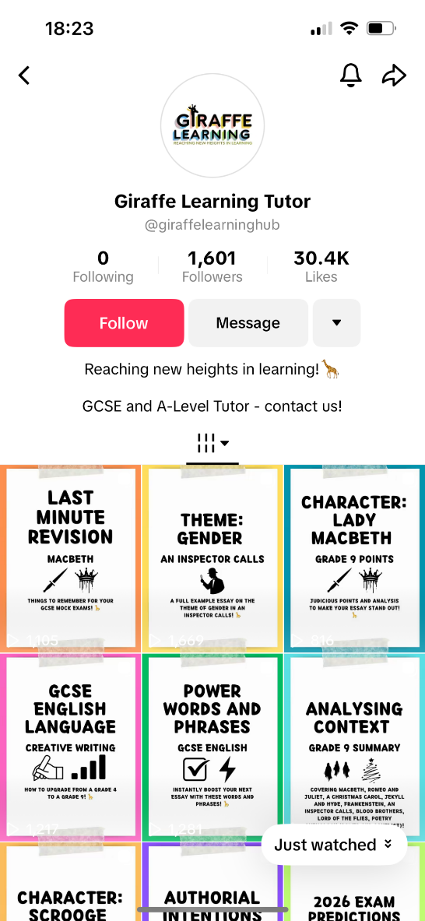
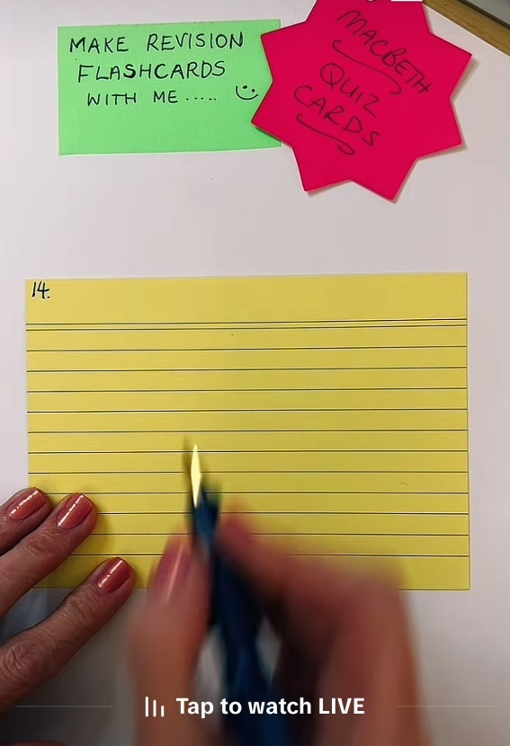
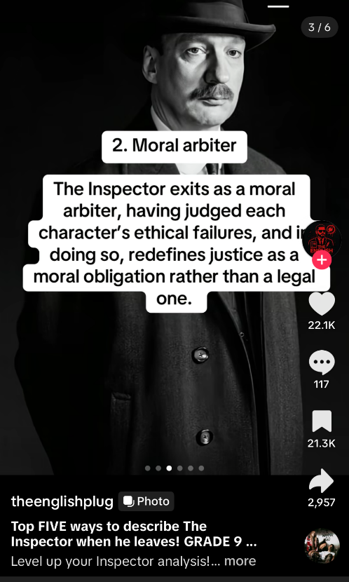
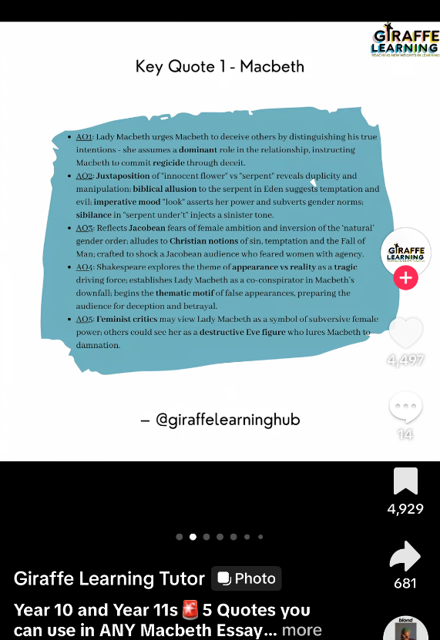
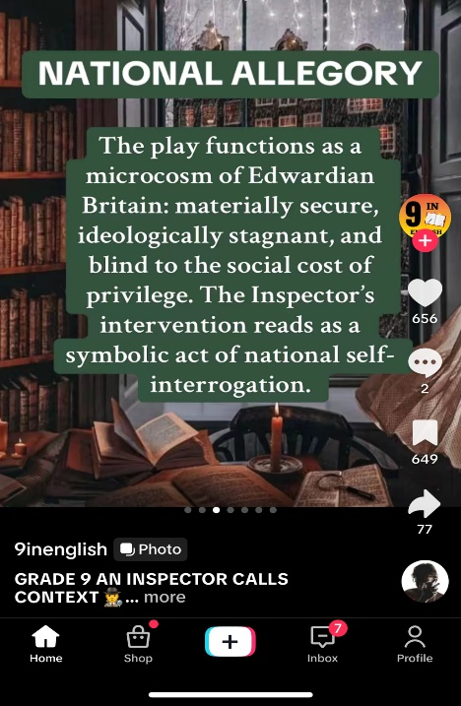
GCSE English
Useful websites/resources:
Mr Bruff YouTube– poetry catch up
BBC bitesize podcasts - https://www.bbc.co.uk/bitesize/articles/zdrk7v4#z2w2p9q
https://www.sparknotes.com
https://revisionworld.com/a2-level-level-revision/english-literature-gcse-level
https://www.firstratetutors.com/flashcards/christmas-carol-pack - buy ready made flashcards (£3.99)
TikTok handles:
GCSE English Teacher @lisagcseenglish
GCSE English Tutor @sarahteachesgcseenglish
The Light Up Tutor @thelightuptutor
@9inEnglish
@giraffelearninghub

Slide 32
Science
Ms Willis

Slide 33

Specification details
AQA
Biology 8461, https://www.aqa.org.uk/subjects/biology
Chemistry 8462, https://www.aqa.org.uk/subjects/chemistry
Physics 8463, https://www.aqa.org.uk/subjects/physics
Combined Science, Trilogy 8464, https://www.aqa.org.uk/subjects/science
Separate Science = 1 hour 45 minutes x 6 papers, 3 GCSEs
Combined Science = 1 hour 15 minutes x 6 papers, 2 GCSEs

Slide 34
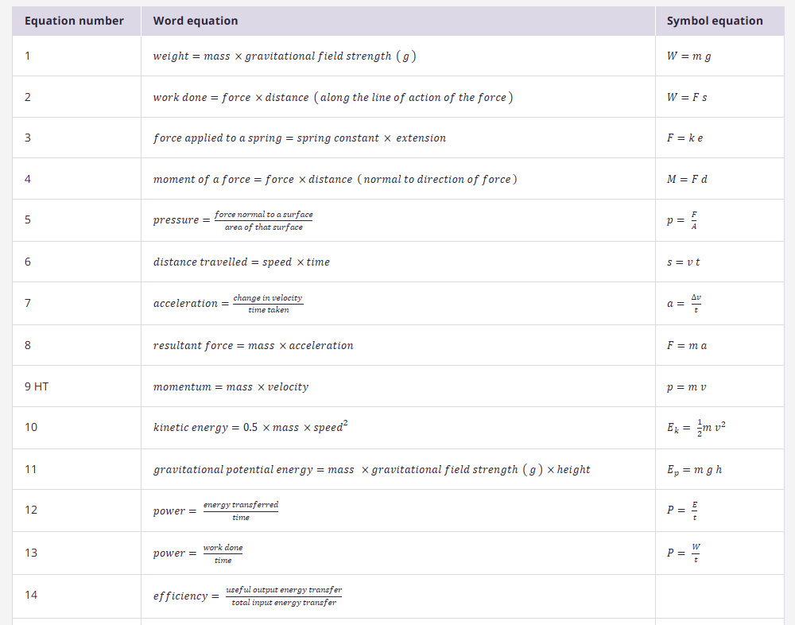
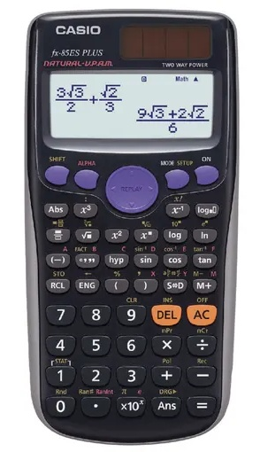
2026:
Formula sheets for Physics and Combined Science Physics will be provided
Notes:
Equation sheets given 2022, 2023, 2024 and plan is to provide up to 2027 as well

Slide 35

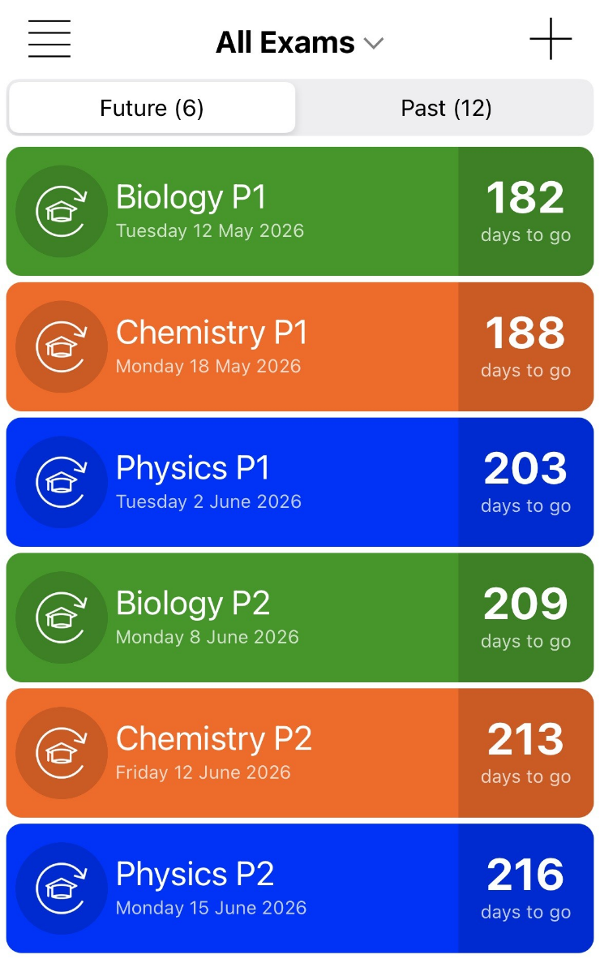
GCSE Separate and Combined Science EXAM DATES
Exam Countdown Lite
Biology Paper 1, Tuesday 12th May
Biology Paper 2, Monday 8th June
Chemistry Paper 1, Monday 18th May
Chemistry Paper 2, Friday 12th June
Physics Paper 1, Tuesday 2nd June
Physics Paper 2, Monday 15th June
Notes:
Difference is separate science exam = 1 hour 45 minutes, combined science = 1 hour 15 minutes
F and H tier all taken at the same time.
App = £4.99 for the year, or free for the Lite version, don’t really need the paid for version (add free, sync with other devices, alerts) really simple, can add icons and different colours.
Add dates to your regular calendar too and phone calendars can give you alerts nearer the time too.
Mocks second and third week back after Christmas

Slide 36
Topics covered on each paper
– see specification
Combined Sciences
Working scientifically & Practical Skills – all papers
Biology Paper 1, Topics 1-4
Biology Paper 2, Topics 5-7
Chemistry Paper 1, Topics 8-12
Chemistry Paper 2, Topics 13-17
Physics Paper 1, Topics 18-21
Physics Paper 2, Topics 22-24
Separate Sciences
Working scientifically & Practical Skills – all papers
Biology Paper 1, Topics 1-4
Biology Paper 2, Topics 5-7
Chemistry Paper 1, Topics 1-5
Chemistry Paper 2, Topics 6-10
Physics Paper 1, Topics 1-4
Physics Paper 2, Topics 5-8

Slide 37
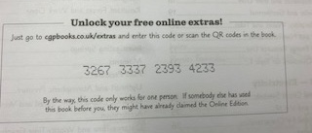
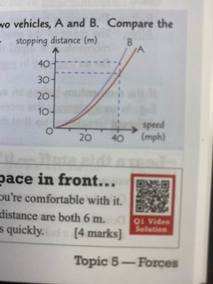
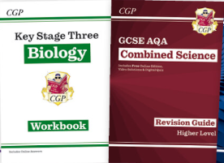
CGP
£12.50 Combined Trilogy
£6.99 each Biology/Chemistry/Physics
www.cgpbooks.co.uk
QR codes take you to videos that work through answers to the questions for you
Access online content. You can only use each code once, but you can use the content on more than one device, you just need to create an account and log in.

Slide 38
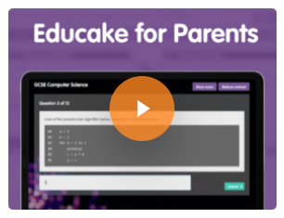
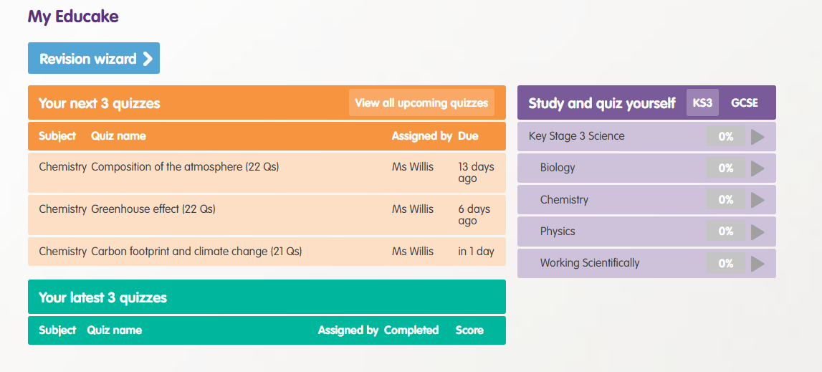
Educake
https://www.youtube.com/watch?v=Y5GEZV6-23k

Slide 39
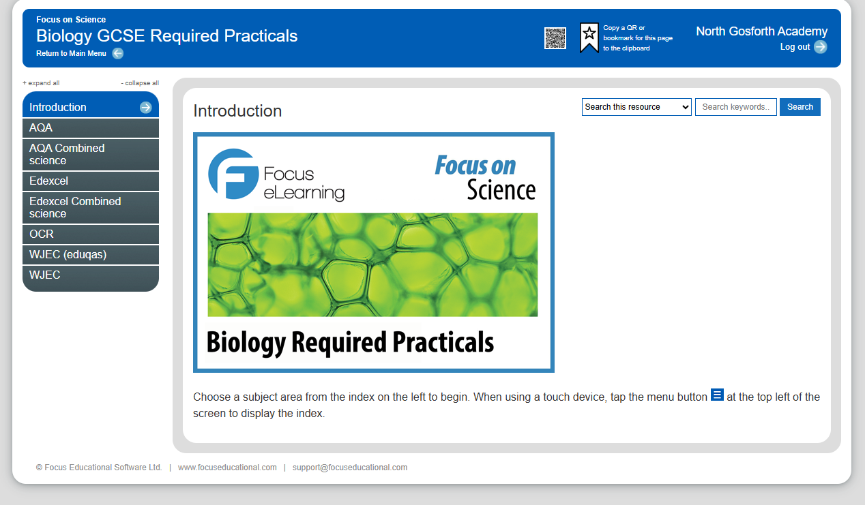
Focus
By visiting: www.focuselearning.co.uk
Username: student@northgosforth39317
Password: g4y0dgqgn

Slide 40
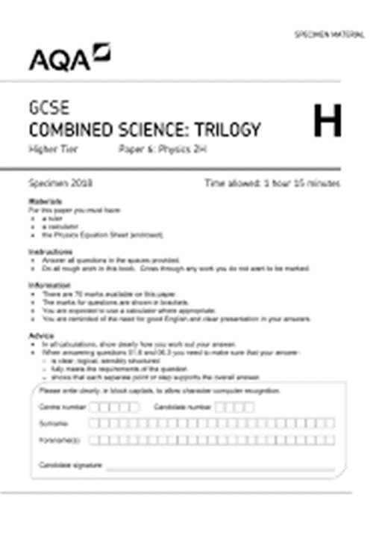
Practice papers
https://www.physicsandmathstutor.com/
From memory
Using revision guide/ notes
Use mark scheme/ examiner reports
Make a bank of questions from exam papers

Slide 41
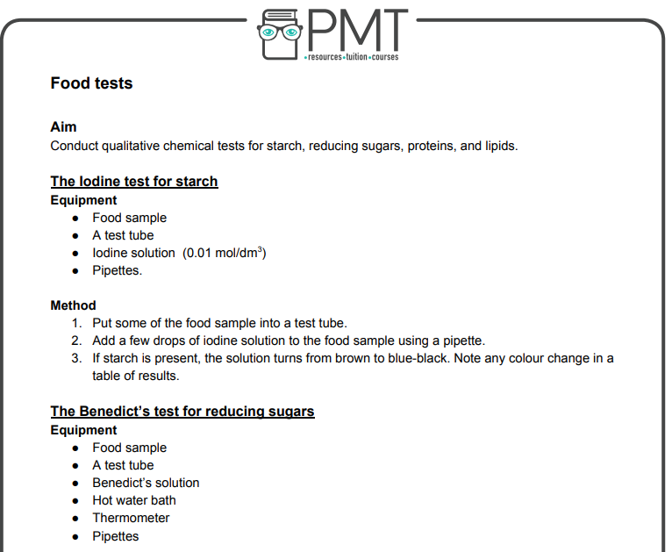
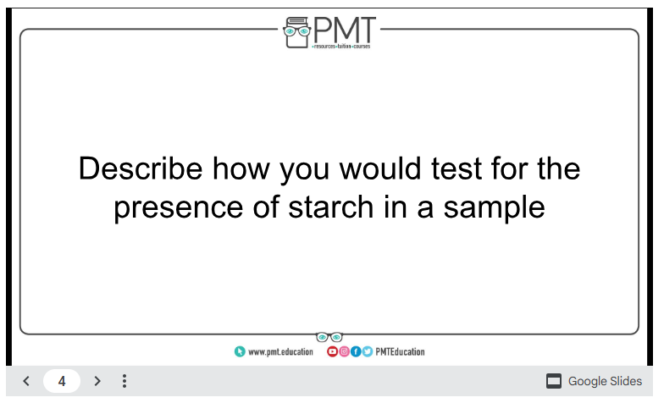
Also, flashcards, notes, mind maps

Slide 42
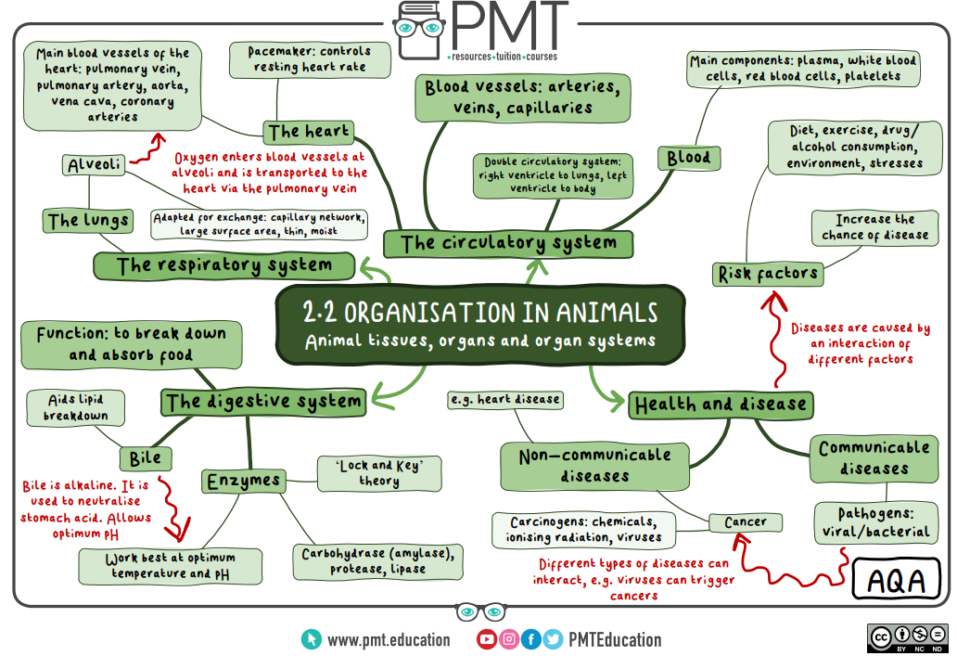

Slide 43
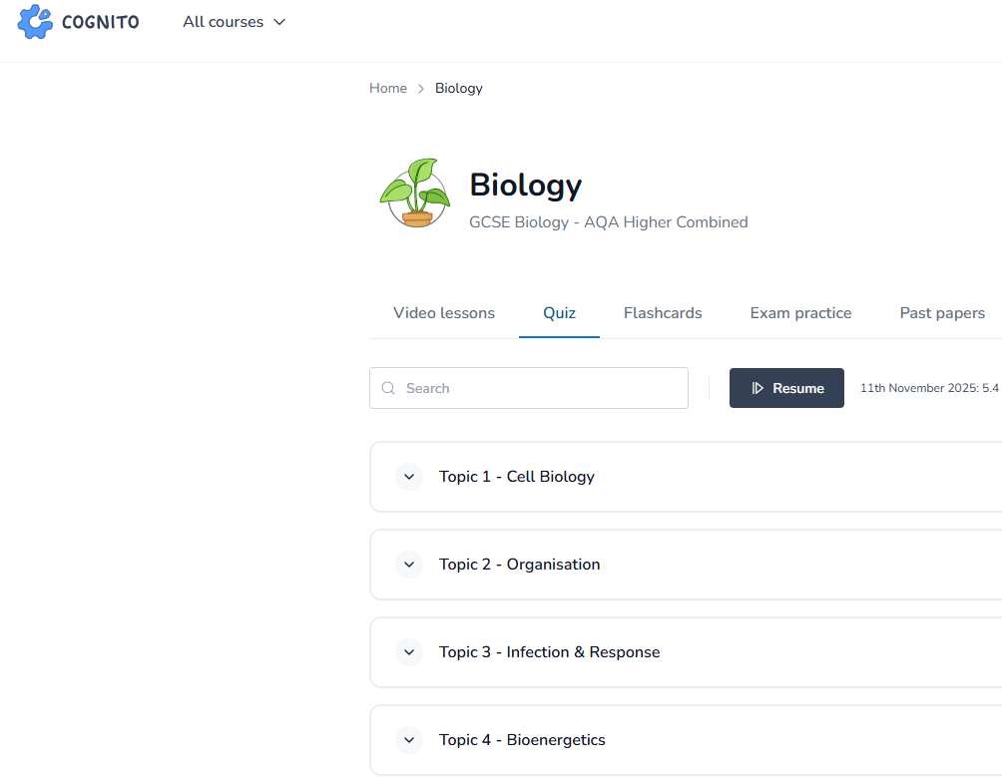
Cognito
https://cognitoedu.org/home

Slide 44
Some tips
Start small but make a start!
Get organised – make a timetable and plan what you will try and cover each session
Include the things you find most difficult
Don’t copy out the revision guide - be active, do something from memory every time you revise
Notes:
10 min a day isn’t a big ask, but little steps compound and build up over time
So if they read/ watch a video, write down what they remember at the end

